Slide 1

Session 17:
AI That Combines Everything - Multimodal AI

Slide 2
Objectives
By the end of this Session, you'll be able to:
01
02
03
Define Multimodal AI
Know Modalities
See AI Combine Senses
Explain what Multimodal AI is in your own words
Understand what a modality is — words, pictures, sounds, video
Discover how AI combines senses to do amazing things
04
05
06
Use Leonardo
Use Gamma
Connect the Framework
Turn your words into a video with Canva's Leonardo
Turn your words into a full slideshow presentation
Link back to the Sense → Think → Act framework from Session 1

Slide 3
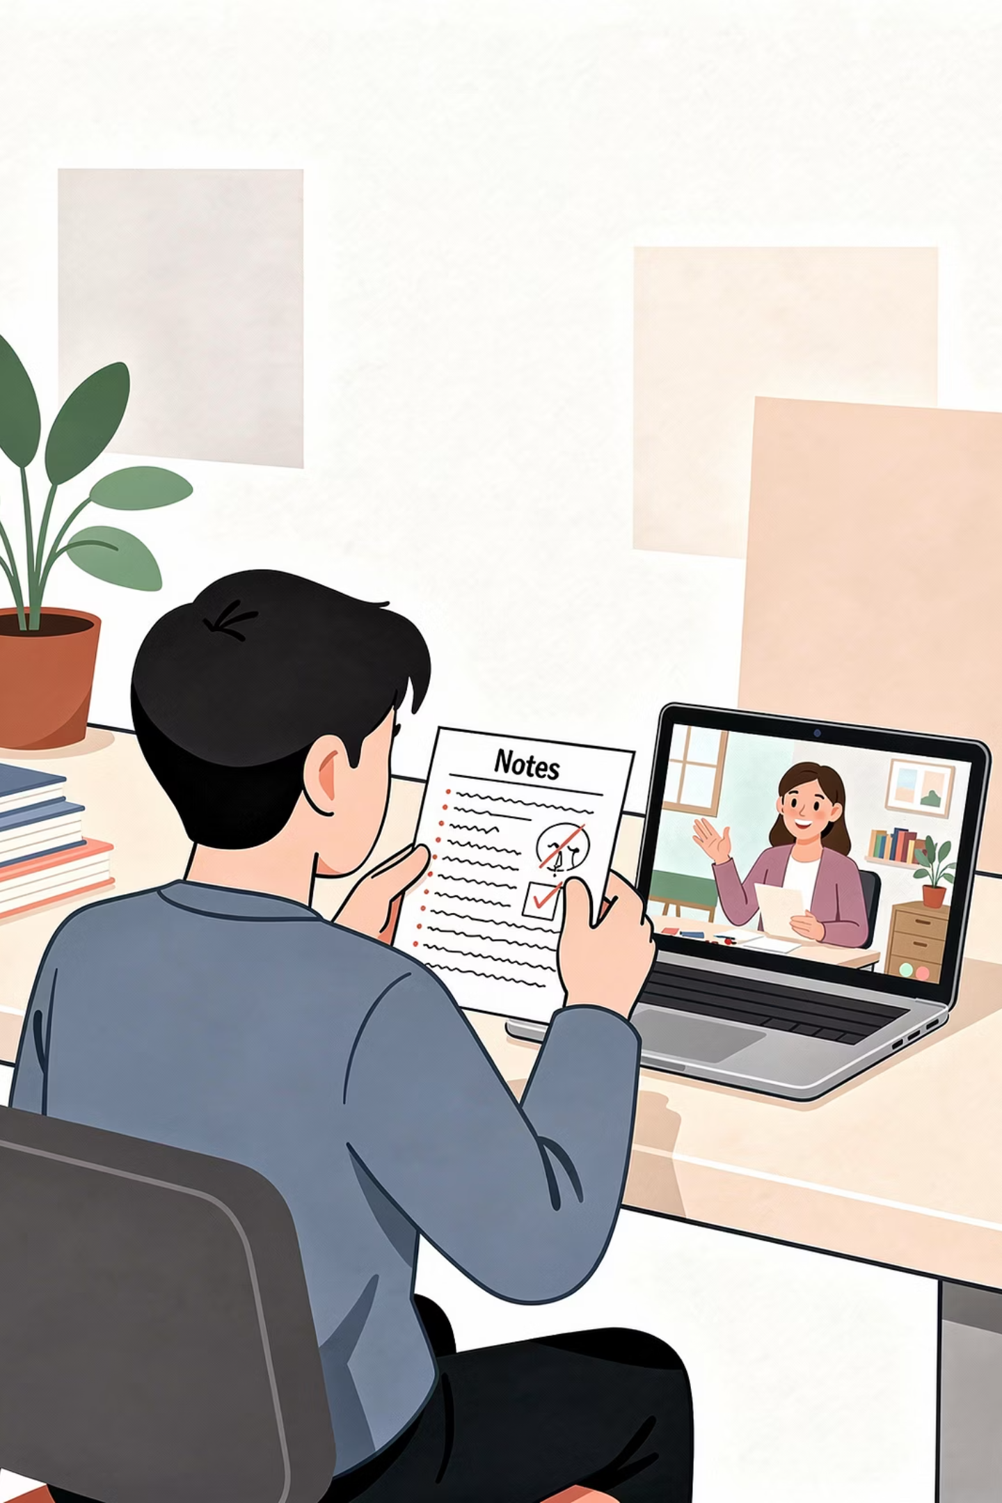
Recap & Homework
Reflection Questions
Where did you spot Voice AI?
Did your hands-on make a fun AI voice?
Did any Voice AI mishear you?
Quick Check from Last Module
NLP recipe?
CV recipe?
Voice AI recipe?

Slide 4

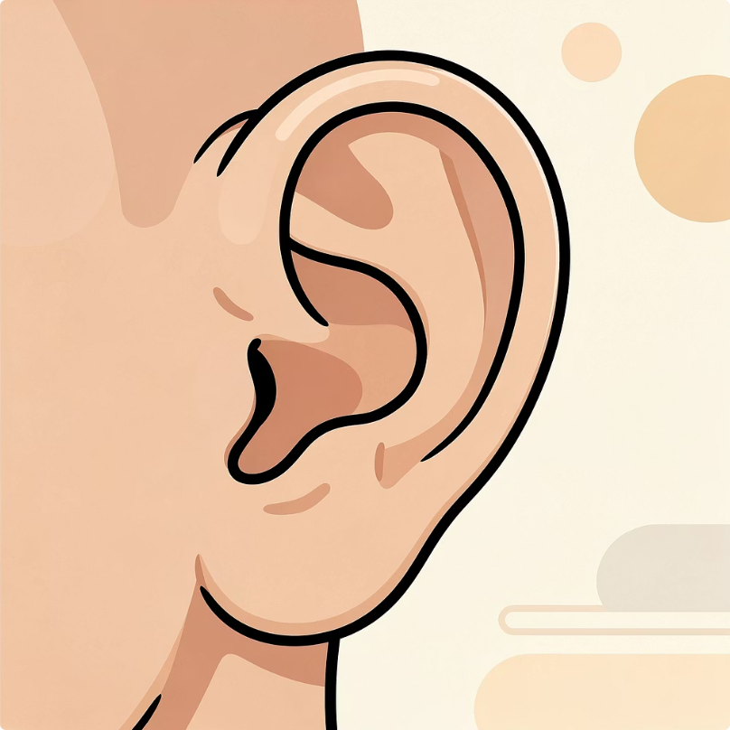



Warm-Up : How Do YOU Use Your Senses?
SEE
HEAR
FEEL
SMELL
You use ALL your senses TOGETHER. You don't just "see." You see + hear + feel - all at once.
Big question: What if AI could do that too?

Slide 5





What's a "Modality"?
Modality is a TYPE of input or output. Don't be scared by the word - it just means a "kind of sense" for AI.
Text
Image
Audio
Video
Code

Slide 6

What is Multimodal AI?
Multimodal AI = AI that uses MORE THAN ONE modality at once.
Text → Image
Write a story prompt, get a picture
Image → Text
Show a photo, AI describes it
Video → Text
YouTube auto-summaries
Text → Video
Write a prompt, generate a video

Slide 7
Remember
Sense → Think → Act?
We learned: ALL AI follows this pattern and Multimodal AI takes it to the next level.
AI Type
Sense
Think
Act
📖 NLP
Break (words)
Understand
Generate
👁️ CV
See (pixels)
Process
Act
🎤 Voice
Hear (sound)
Process
Speak
🤯 Multimodal
ALL of the above
All at once
Multiple ways

Slide 8

Mini Activity 1 - Spot the Modalities!
For each example, name the modalities going IN and OUT. Options: 📝 Text / 🖼️ Image / 🎵 Audio / 🎬 Video
What's happening
IN
OUT
"Draw a dragon" → image
Text
Image
Upload photo → AI describes it
Image
Text
"Make a robot dance video" → video
Text
Video
Speaking English on video → Spanish with lip-sync
Audio + Video
Audio (Spanish) + Video
AI watches game → summary article
Video
📝Text
See the magic? Different modalities IN, different OUT. Sometimes both. The MORE modalities AI can combine, the MORE useful and powerful it gets.

Slide 9
Why Multimodal AI is a BIG Deal
Before Multimodal AI - You had separate tools that couldn't talk to each other:
With Multimodal AI - One AI can do it ALL simultaneously:
One AI for text
One AI for pictures
One AI for voice
They couldn't really "talk" to each other
Look at your photo
Read your question
Think about both at once
Answer with words OR pictures OR a video

Slide 10
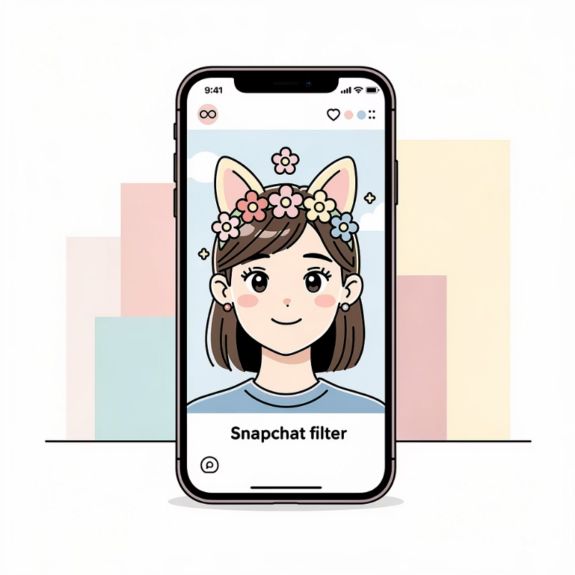


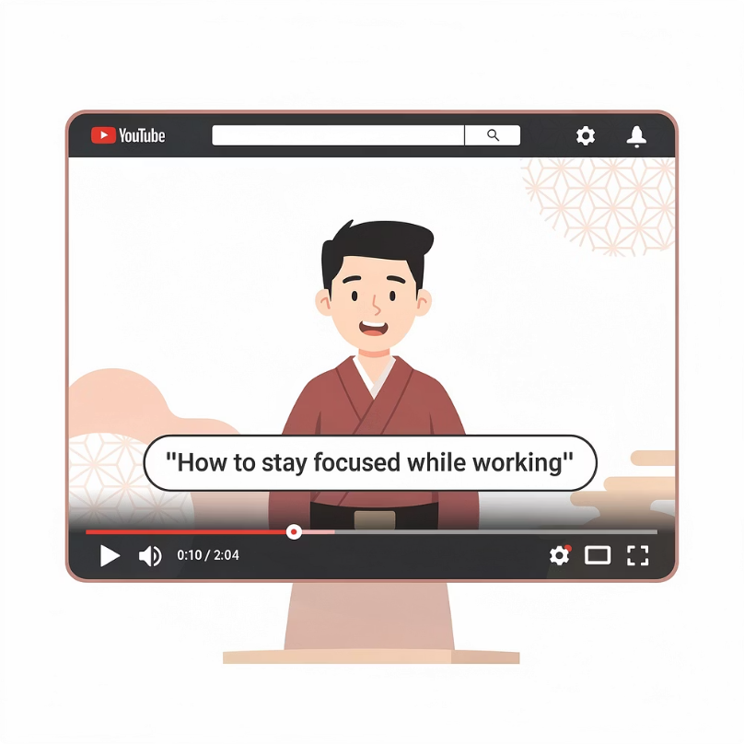
Multimodal Examples You've Already Used
Snapchat Filters
Siri Search Results
Google Lens
YouTube Auto-Captions
Camera (vision) + tracking your face (vision) + voice prompts (voice)
Voice (you talking) + text (search results) + sometimes images
Camera + text - translates signs in real-time
Audio (the voice in the video) + text (captions on screen)

Slide 11
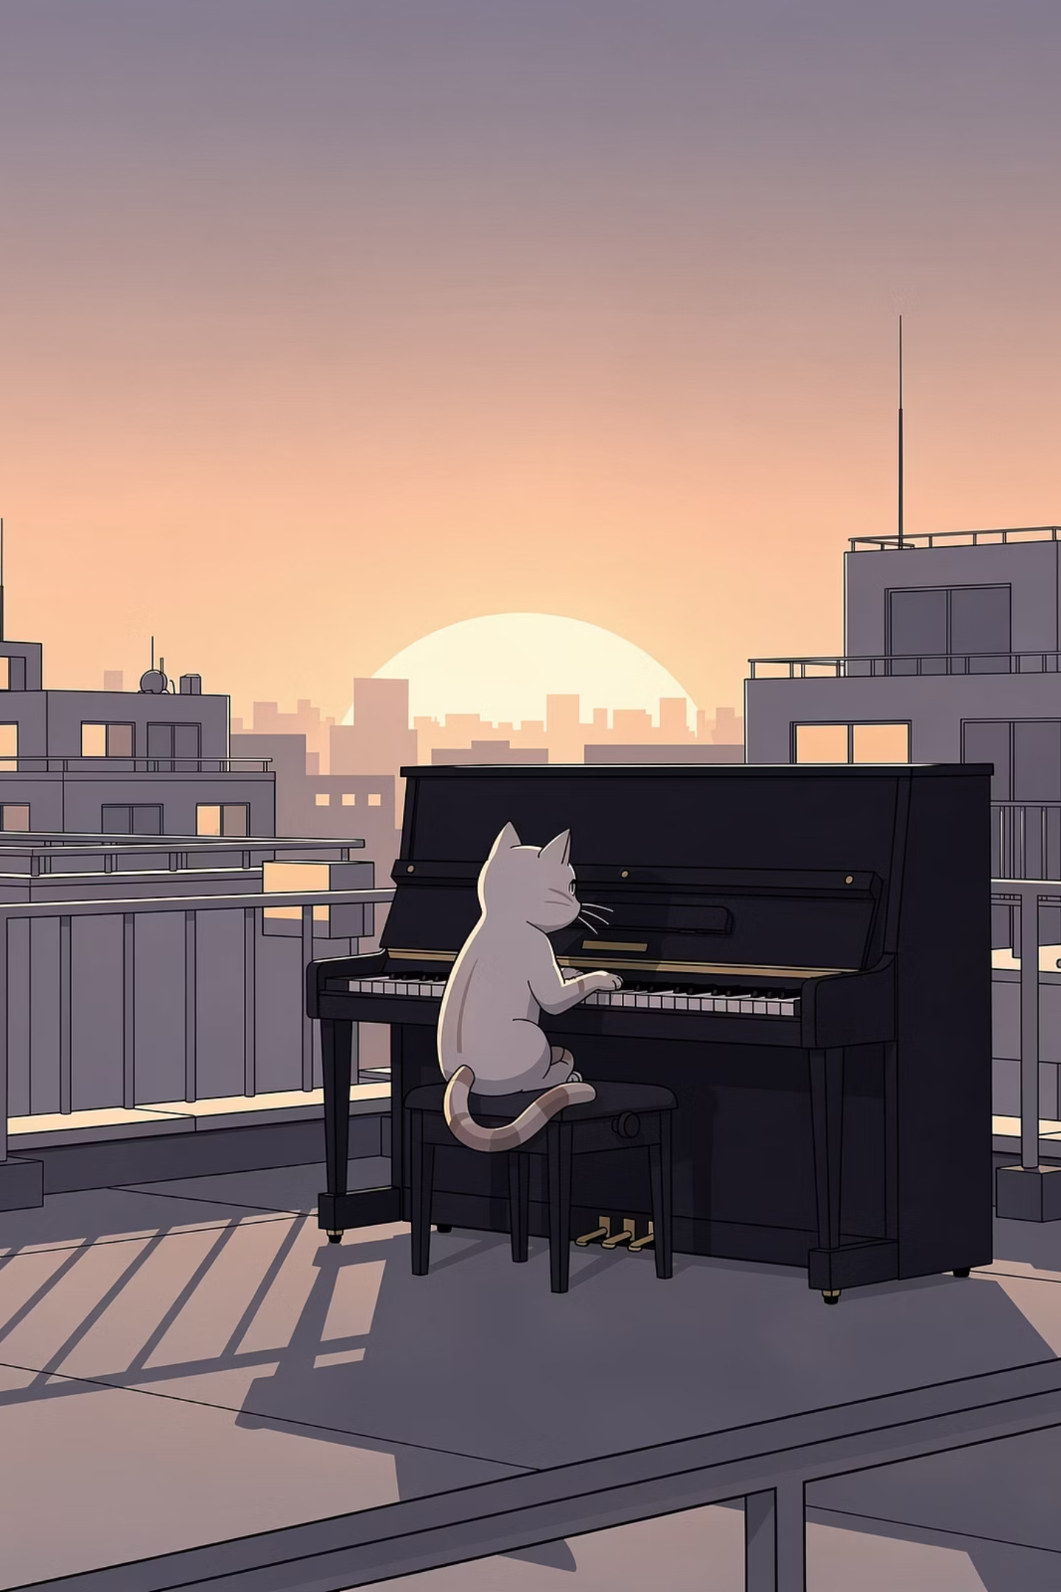

The Magic of Text → Video
One of the coolest multimodal jobs: turning a sentence into a video.
You type: "A cat playing piano on a rooftop at sunset."
🐱 Subject - What does a cat look like?
🎹 Object - What does a piano look like?
🌅 Lighting - What does sunset lighting look like?
🎬 Motion - How do these things move and combine?
AI generates: 🎬 a real video of exactly that scene! All from one sentence. 🤯

Slide 12




Meet Leonardo 🎬
Leonardo.Ai is a powerful, creator-first generative AI platform designed for producing professional-quality images, textures, and videos.
Generate Video Clips
Make Objects Move
Lighting & Atmosphere
Matching Audio

Slide 13

Mini Activity 2 - Plan Your Video!
Before we generate, let's plan a great video prompt.
🎯 Action
🎬 Subject
🌍 Setting
✨ Style
🎥 Details
Try this template: "[Subject] is [doing action] in [setting]. [Style + details]."
Example: "A golden retriever is surfing on a giant pizza in the ocean. Cartoon style, bright sunny day, happy mood."

Slide 14


Sample Prompts to Try
Pick one - or write your own! Your prompt should be SPECIFIC and DESCRIPTIVE.
🐉 Dragon Teacher
🚀 Moon Dancer
🦖 Chess Match
"A friendly dragon is teaching a class of children. Cartoon style, magical school, warm lighting."
"An astronaut is dancing on the moon. Realistic style, stars in the background, slow-motion."
"A T-Rex is playing chess against a robot. Funny cartoon, dim room, dramatic chess music."
🌊 Whale at Sunset
🐱 DJ Cat
"A whale is leaping out of the ocean at sunset. Cinematic, glowing orange sky, slow motion."
"A cat is wearing sunglasses and DJing at a beach party. Cartoon style, palm trees, party lights."

Slide 15
Hands-On Activity Part 1 - Make Your Video! 🎬
Time to generate.
Open Leonardo
Paste Your Prompt
Click Generate
Wait 30–60 Seconds…
Watch the Video!

Slide 16
What Just Happened?
Behind the scenes, Leonardo did something WILD. It combined everything you've learned in Module 5:
📝 Read Your Prompt
🧠 Understood Every Part
🖼️ Generated Pixels
🎬 Strung Frames Together
🎵 Added Matching Sounds
That's ALL THREE modalities working together.

Slide 17

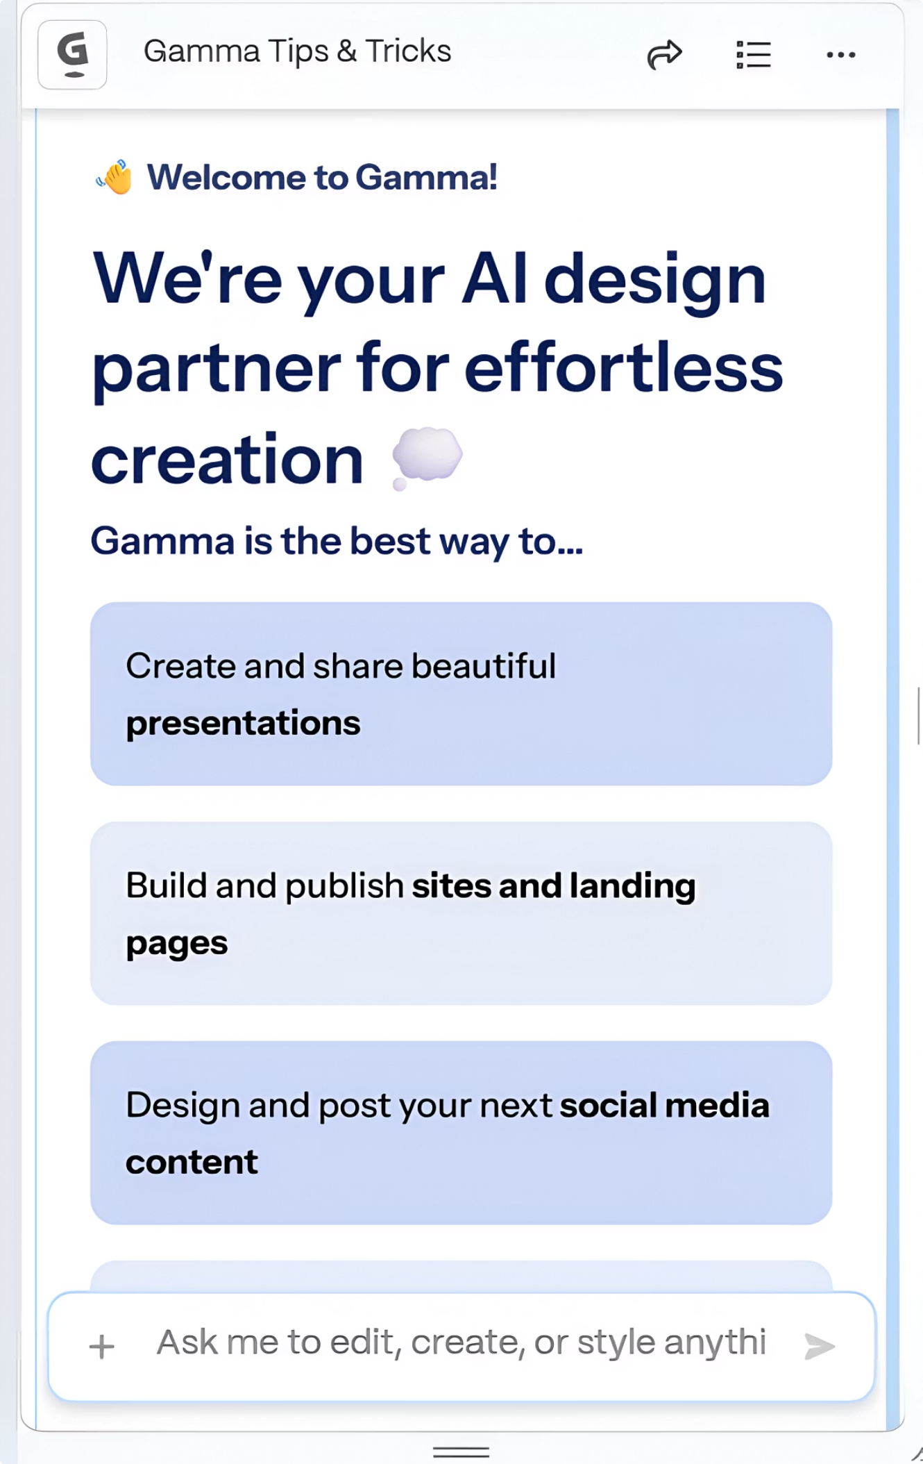
Meet Gamma - Multimodal for Slides!
Gamma is another multimodal AI - but for SLIDES and PRESENTATIONS.
You give it a topic. It makes an entire slideshow.
📝 Text for Slides
🖼️ Images & Icons
🎨 Layout & Design
✨ Full Presentation

Slide 18

Hands-On Activity Part 2 - Make Your Slides! 📊
Steps to Follow
Open gamma.app
Click "New" → "Generate"
Type a topic - anything you want!
Watch Gamma build you a complete slideshow
In 30 seconds, you'll have a full presentation. 🤯
Topic Ideas to Try
"Top 5 facts about dolphins for a school project"
"A presentation on mythical creatures"
"Climate change explained for 5th graders"
Or pick your own topic - something you're passionate about!

Slide 19
Compare Leonardo and Gamma
Feature
Leonardo 🎬
Gamma 🎨
Input
Text prompt
Topic / outline
Output
Short video
Full slideshow
Best for
Storytelling, creative scenes
School projects, presentations
Modalities mixed
Text → Video + Audio
Text → Text + Images + Design
Speed
30–60 seconds
~30 seconds

Slide 20
Reflection - What Did You Notice?
Multimodal AI is powerful. The more powerful, the more careful we have to be.
Discussion Questions
Which tool did you like better - Leonardo or Gamma?
What surprised you about each one?
What did AI get RIGHT? What did it get WRONG?
Bigger Questions
✨ Cool side: Where could you use these for school? Or for fun? Or for storytelling?
⚠️ Careful side: What if someone made a FAKE video of someone real? Could it fool people?

Slide 21
What We Learned in this Session
Modality
Multimodal AI
Sense → Think → Act
A type of input or output - text, image, audio, video
AI that uses more than one modality at once
The unifying recipe for ALL AI
Leonardo
Gamma
Text → video - and you made one!
Topic → full slideshow - and you made one!

Slide 22
Your Homework - Multimodal Detective 🔍
Find Multimodal AI in your daily life this week. Mission: Spot 3 examples of AI using MORE THAN ONE modality.
Examples to Look For
📷 Snapchat or Instagram filters
(vision + sometimes audio)
🎥 YouTube auto-captions
(audio → text)
🌐 Google Lens
(camera + text recognition)
📱 ChatGPT with image upload
(image + text)
🎬 AI-generated videos online
(text → video + audio)
Gamma making slides from a prompt
(text → image + slides)
What
Modalities IN
Modalities OUT
Example 1
Example 2
Example 3

Slide 23
Challenge🌟
Want a stretch? Combine TWO modalities into one creation!
✍️ Write a Story
🖼️ Generate an Image
🎤 Add Narration
🎬 Generate a Video
Story + Narration (ElevenLabs)
= Audiobook 🎧
Story + Video (Leonardo)
= Mini-Movie 🎬
Image + Narration (ElevenLabs)
= Narrated Illustration 🖼️🎤

Slide 24
Next Time: Session 18
AI in Everyday Life & Across Industries
Farming
Music
Sports
Education
Games
Transportation
Medicine
Finance

